Slide 1

Case Study Presentation
on
Speaker Voice Normalization for End-to-End Speech Translation
Team Members
Mettu Siddhartha BL.EN.U4AIE21080
Sathyavarapu Sri Jaswanth BL.EN.U4AIE21116
Date: 14-03-2024
Course : AI in Speech Processing - 21AIE315
AIE 6th sem – E Sec

Slide 2
Journal Paper Referred
Zhengshan Xue, Tingxun Shi, Xiaolei Zhang, Deyi Xiong,“Speaker voice normalization for end-to-end speech translation”,Expert Systems with Applications,2024

Slide 3
Contents
Introduction
Preliminary Experiments
Dataset & Preprocessing
Architecture
Result

Slide 4
Introduction
In recent years shift of research focus from cascaded speech translation (ST) to end-to-end (E2E) speech translation.
In terms of translation quality, most models take raw acoustic signals as input.
Acoustic voice characteristics is different for person to person.

Slide 5
Preliminary Experiments
Investigated impact of acoustic voice variation on speech translation
Utilized TTS to synthesize audio from transcripts
Trained models with raw vs. synthetic speech inputs
Compared performance of models

Slide 6
Dataset & Preprocessing
They used widely used MuST-C Dataset.
The English-to-German (En-De) task, which is the most commonly utilized task
It comprises 234,000 sentences of text and 408 h of audio.
dev was used as the validation dataset and tst-common was used as the test dataset.

Slide 7
Dataset & Preprocessing
Employed a publicly available ESPnet2-TTS to generate synthetic audio signals.
Model is based on fairseq toolkit.
They used,
Adam optimizer
Early stopping
Dropout and label smoothing
Used the base architecture of wav2vec 2.0 as the speech encoder.

Slide 8
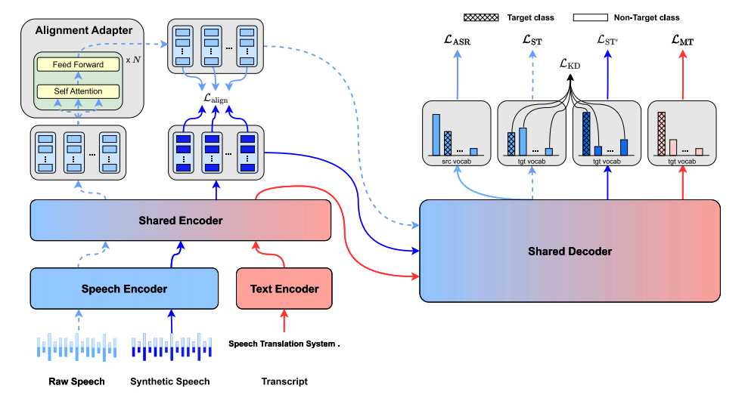
Architecture

Slide 9
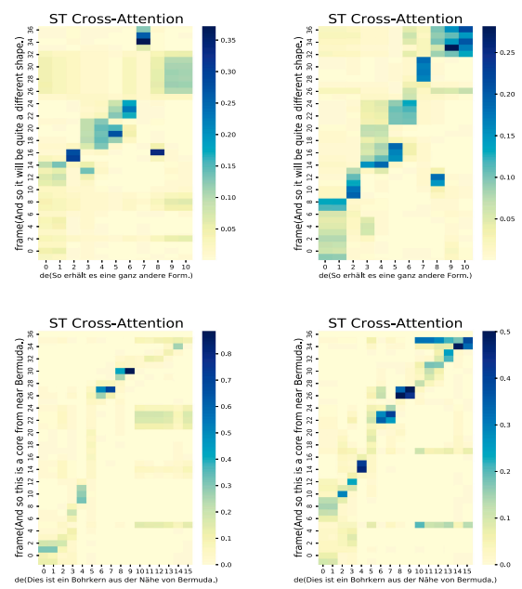

Result
Preliminary Experiments,

Slide 10
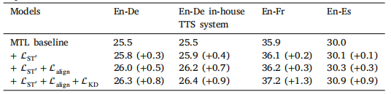

Result
Model,

Slide 11
Thank You

